Slide 1
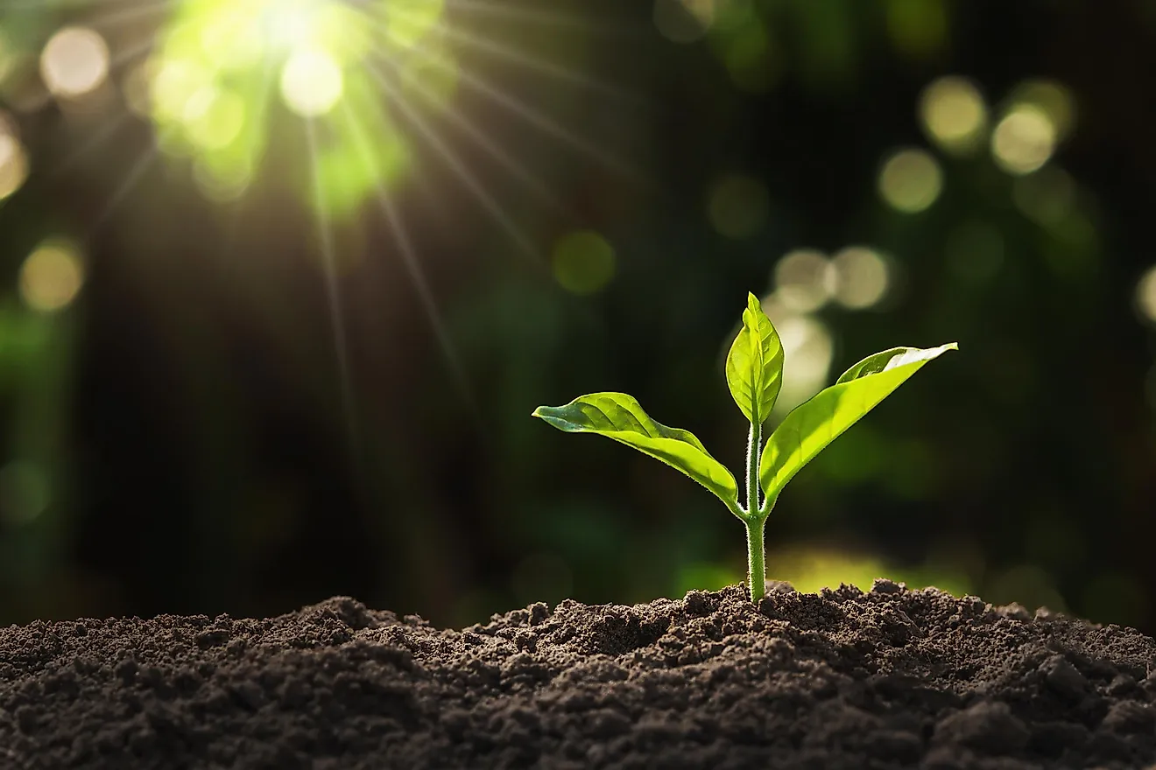
Identification of Different Medicinal Plants

Slide 2

Abstract
Plants have been a source of medicinal remedies for centuries,offering a vast reservoir of potentially beneficial compounds. This addresses the critical need for efficient and accurate identification of diverse medicinal plants and raw materials in the field of herbal medicine and pharmaceuticals..
Medicinal plants have been used for centuries to treat various ailments, and their demand continues to rise due to their potential therapeutic benefits. However, the accurate identification of these plants remains a challenging task, often relying on the expertise of botanists and traditional knowledge, which may be limited and time-consuming.
This research aims to revolutionize the process of medicinal plant identification by harnessing the power of image processing and machine learning techniques.

Slide 3
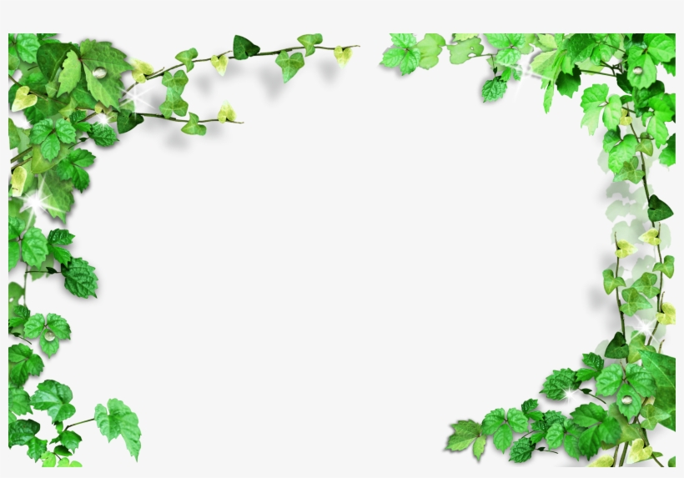
Introduction
Welcome to the presentation on "Addressing Medicinal Plant Identification Challenges through Machine Learning.“
India is renowned for its rich heritage of floral diversity and traditional medicinal practices.
Ayurvedic Pharmaceutics relies heavily on medicinal plants as key ingredients for various treatments.
However, a major issue plaguing the field is the accurate identification of these plants.
This problem stems from various factors, including the sale of different crude drugs under the same name in the market.

Slide 4
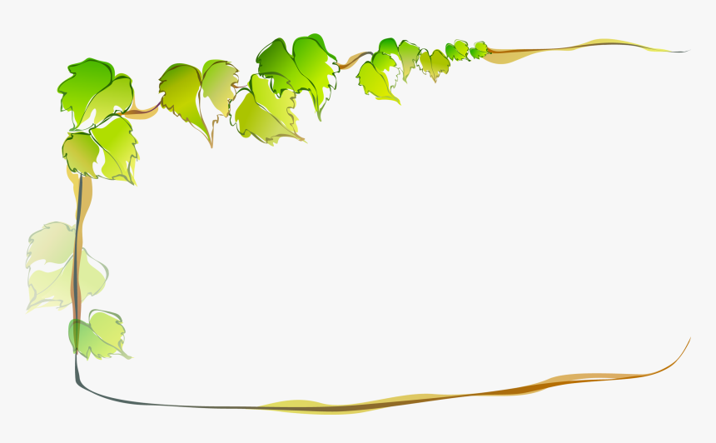
Introduction con..
Such confusion and misidentification can have serious consequences, including ineffectiveness of treatments.
Even collectors and traders often struggle with identifying plants due to seasonal and geographical variations and similar characteristics.
The high demand for medicinal plants places immense strain on existing resources, leading to adulteration and substitution practices.
This presentation explores how software utilizing Image Processing and Machine Learning can provide a solution to these challenges.
Such software has the potential to benefit every level of the supply chain, from wholesalers to distributors, ensuring the authenticity of raw materials used in the Ayurvedic system.

Slide 5

Objectives
To develop a robust and accurate machine learning model for the automated identification of medicinal plant species.
To create a comprehensive database of botanical and chemical information about various plant species, including their scientific name and other additional information.
To evaluate the effectiveness of different machine learning algorithms in predicting the medicinal plants based on their characteristics and chemical composition.
To develop user-friendly software or applications that make the knowledge and predictions regarding medicinal plants accessible to researchers, herbalists, and healthcare professionals.
To contribute to the discovery of novel natural remedies and the sustainable utilization of plant resources for pharmaceutical and healthcare purposes.

Slide 6

In this initial stage, we input a plant image, which is then subjected to detection. Subsequently, We can deploy Google lens by using ML kit provided by Google.
ML kit is a mobile SDK that brings Google’s on-device machine learning expertise to Android and iOS apps.Use our powerful yet easy to use Vision to solve common challenges in our apps.
This outputs the plant name, and the plant name is stored in software module.
The plant name is retrieved and then given to a model and the model predicts the class variable and the class is a medicinal or ordinary plant.
For the model, we use the classification algorithm to a dataset consisting of medicinal properties of the plant.
Methodology

Slide 7
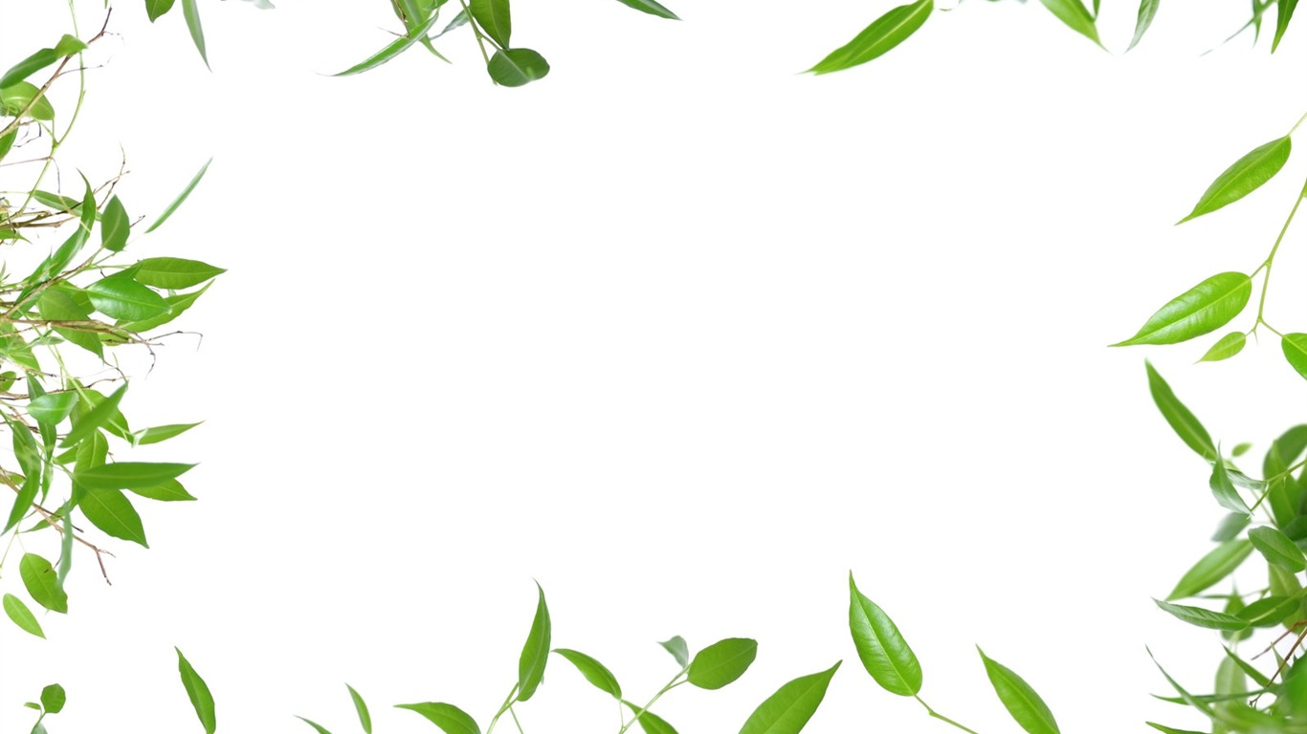
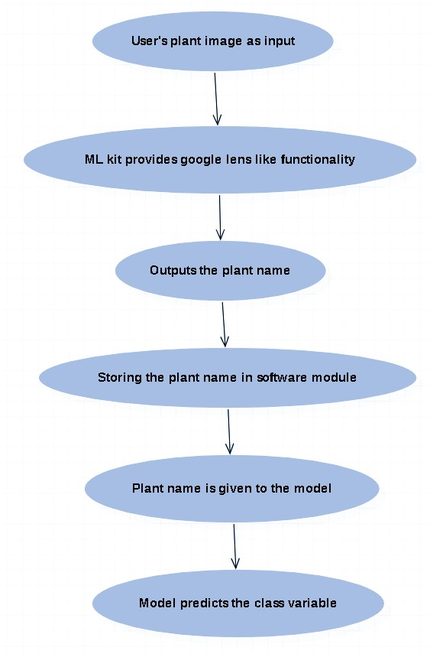
Methodology con..

Slide 8
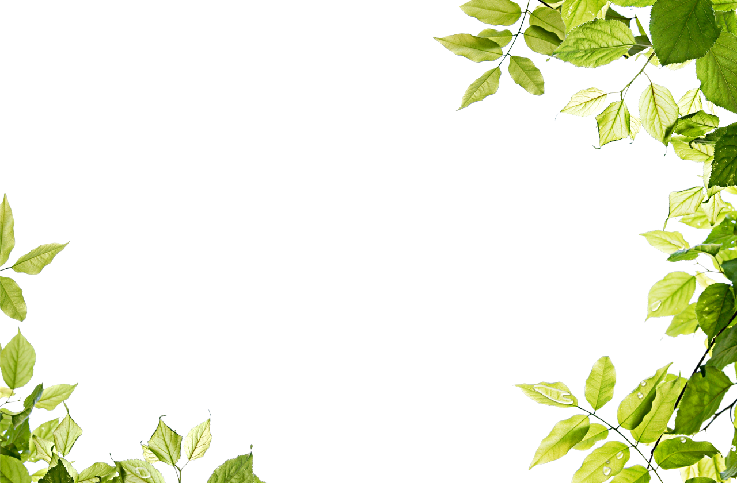
Technology Stack
Mobile App Development :Develop native mobile app for iOS and Android platforms using python framework technology i.e Django. It is more feature-rich and high-level web framework.
Database Management : Utilizes database SQLite. As it is a lightweight, embedded relational database management system that is often the default choice for mobile app development, especially on platforms like Android and iOS. It is often used for offline data storage.
Image Processing : Technology used for identifying the plant name is Google lens ,But google lens is not directly integrated into third-party Android apps. However ,Google provides an ‘ML Kit’ Supported by Android that we can integrate into our app.ML kit offers various vision and NLP APIs that can help you create our own Google Lens-like functionality .

Slide 9
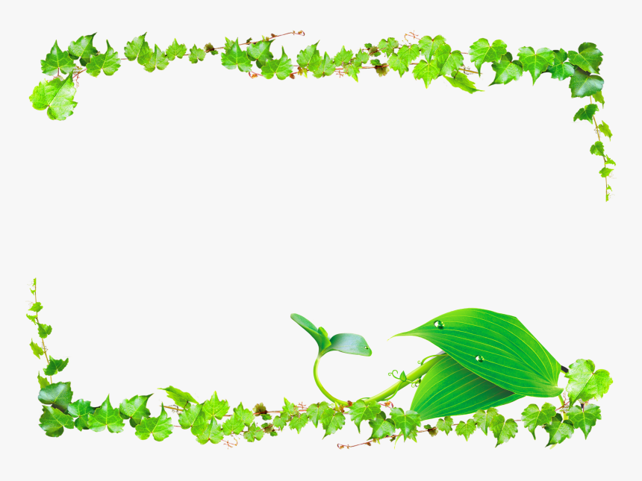
Conclusion
Our app possesses the capability to detect and distinguish various medicinal plants, enabling us to efficiently classify both common and medicinal plant species.
This application is highly efficient, consuming minimal time and space, because of its integration with Google Lens. By leveraging Google Lens APIs, it streamlines image detection tasks.
In the future, we intend to incorporate additional modules into the app, such as displaying the medicinal properties of plants and indicating the diseases for which they are used.

Slide 10


